Slide 1


Titolo presentazione sottotitolo
Improving DaaS with Kubernetes in Fog
Computing Environments
Milano, XX mese 20XX
Relatore: Prof. Monica Vitali
Correlatore: Prof. Pierluigi Plebani
Presented by: Sun Chao

Slide 2
CONTENT
BACKGROUND
RESEARCH GOALS
CUSTOMIZED MONITORING SYSTEM
DEMO TIME
FUTURE WORK

Slide 3
BACKGROUND
Countless data have also been generated by Internet of Things-based devices. Due to device heterogeneity, data generated by IoT devices usually come with different format and quality.
Data-intensive applications are usually developed based on Cloud resources which can provide reliable and scalable services
Two major challenges raised when designing data-intensive applications by handling these data:
privacy and security
latency

Slide 4
RESEARCH GOALS
Design an architecture which is able to handle data and computation movement between distributed computation resources
Develop a containerized Data Intensive Application which is used in our platform to simulate the data processing activity in order to fit the data requirements
Develop and deploy a customized monitoring system for our platform

Slide 5
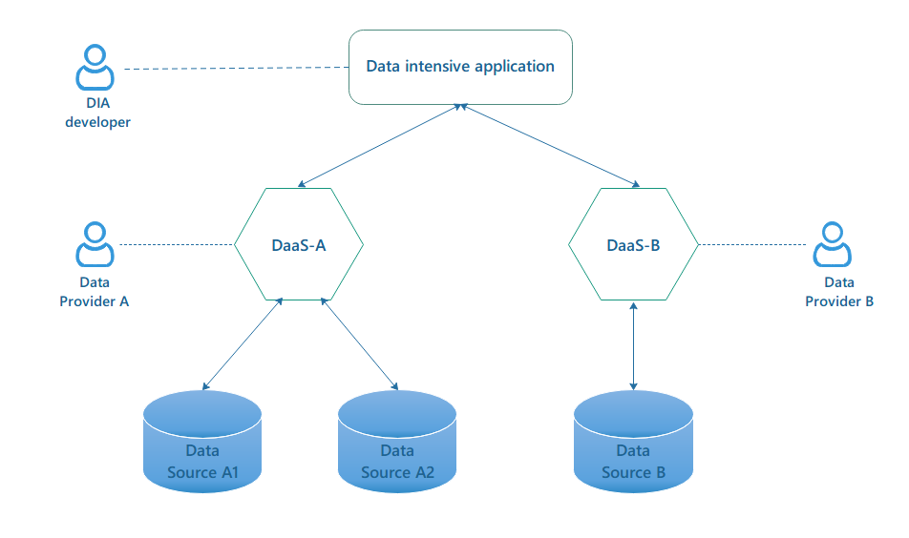
DaaS FRAMEWORK IN FOG COMPUTING
Figure 1: Data-as-a-Service architecture

Slide 6
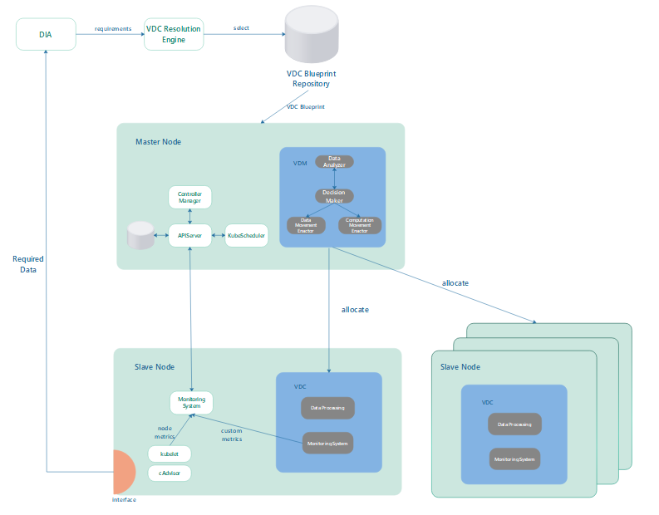
IMPLEMENTATION
Figure 2: Kubernetes architecture overview

Slide 7
CUSTOMIZED MONITORING SYSTEM
Metrics involved in the monitoring system:
Resource metrics:
CPU utilization
Memory utilization
Network throughput
Custom metrics:
Data processing response time
HTTP request number
HTTP request failure number

Slide 8
CUSTOMIZED MONITORING SYSTEM
we decide to select Prometheus as the main monitoring system for two reasons:
Prometheus is able to monitor all the components within a Kubernetes cluster
The custom metrics are usually emitted in Prometheus format
To separate the access priviledge to different types of metrics, we set two Prometheus instances. One is used for monitoring the regular cluster metrics for all Kubernetes objects, and the other one is used to pull custom metrics exposed by some specific applications (VDCs).

Slide 9
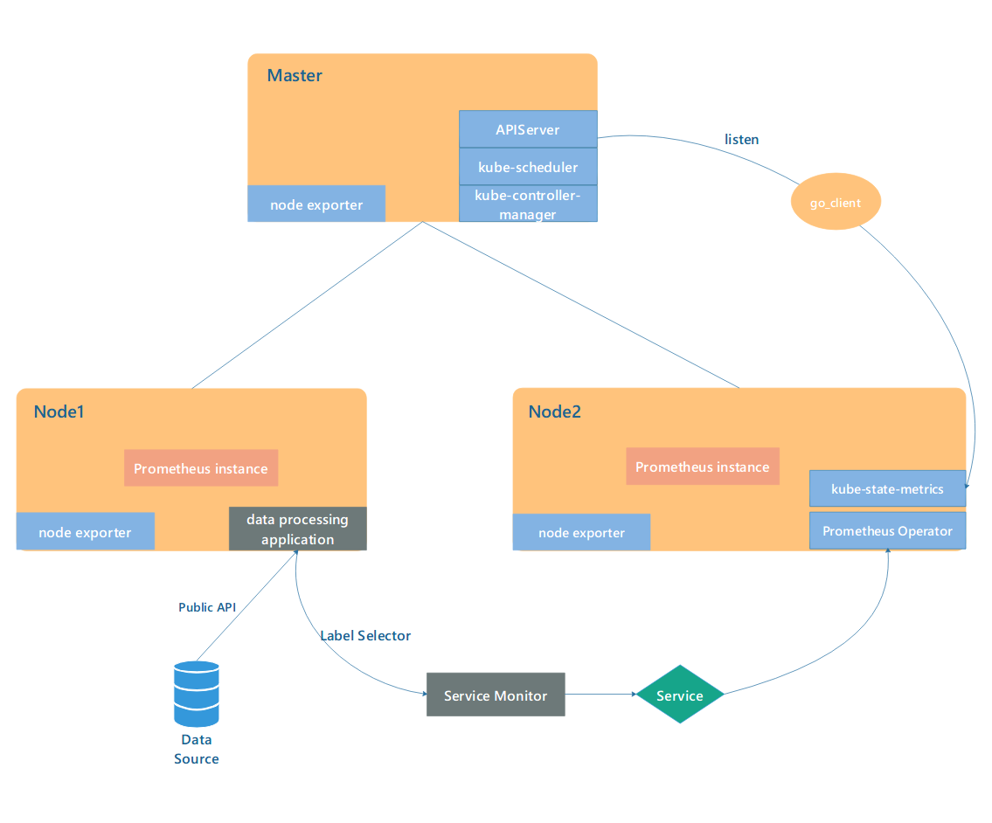
THE DEPLOYMENT OF PROMETHEUS
Figure 3: The Prometheus components inside a Kubernetes cluster

Slide 10
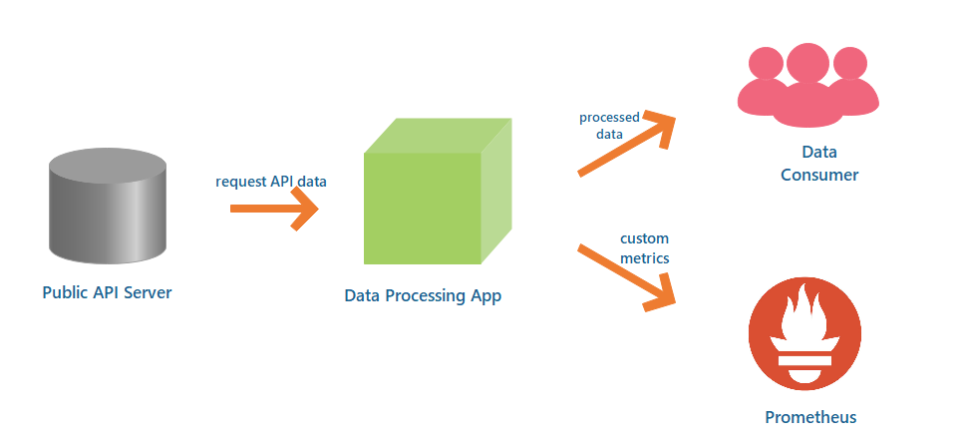
CONTAINERIZED APPLICATION DEVELOPMENT
Figure 4: Data pipeline of the data processing application
Notes:
The Public API Server collects public API services from all over the world through Internet. The base URL for this server is https://api.publicapis.org/.
The instrument application is developed with a Prometheus client library, so that it is able to expose custom metrics in Prometheus format.
By sending GET /category request to the Public API Server, our application is able to receive a JSON file including all the information related with that category.
With the received data, we apply SHA-512 hash transform function to encrypt this data string and then expose the processed data with a REST API.
At the same time, the application exposes the predefined custom metrics to the Prometheus instance through a HTTP endpoint (/metrics).
Finally, the developed application should be packaged into a docker file and stored into Dockerhub repository.

Slide 11
DEMO TIME

Slide 12
FUTURE WORK
Three custom metrics are too limited to track the running states for a huge number of VDCs, more metrics should be designed and attached to our customized monitoring system.
Since the customized monitoring system is ready, we still need to enact a data and computation movement based on the monitoring data. The data and computation movement actions should be triggered by the VDM, which is used to control the activities for its connected VDCs.
The developed platform right now is supported by Cloud Service Provider which provides several Virtual Machines relying on the cloud data-center. To provide a truly Fog Computing environment, some ARM devices(e.g., Raspberry PI) should be connected to our Kubernetes cluster as the edge side.

Slide 13

THANK YOU!
QUESTION TIME

